Slide 1
Freska system
Beshoy adel zekry 19102706
Momen Mohamed massoud 1912610
Reem nasr 19101002
Doc:Hossam abdellatef
Eng:Sohaila el alem

Slide 2
Agend
Include :
WebSite Idea
Website prortotype
WebSite pages
Explane WebSite Pages

Slide 3
WebSite Pages
Sign in_employee_eng
Sign in_employee_arb
Sign in_user_eng
Sign in_user_arb
Sign in_admain_eng
Sign in_admain_arb
Shopping_eng
Shopping _arb
cost_eng

Slide 4
cost _arb:delivary_eng
delivary _arb
Employee page_eng
Employee page _arb:
user page_eng
user page _arb:
Home page_eng
user page _arb:

Slide 5
Login user arb
Login user eng
Login admin arb
Login admin eng
Login employee eng
Login employee arb

Slide 6
advantages
It is for customer to shopping , so can order the goods he likes while he is at home and have fun when he wants
By google maps can he contact with near branch and order product
admain only can create account for employee and enter salary

Slide 7
Disadvantages
it is difficult to convincing people to use this web because they get used to the traditional way
If product is finished when people order maybe a crash occurs and the program does not modify

Slide 8
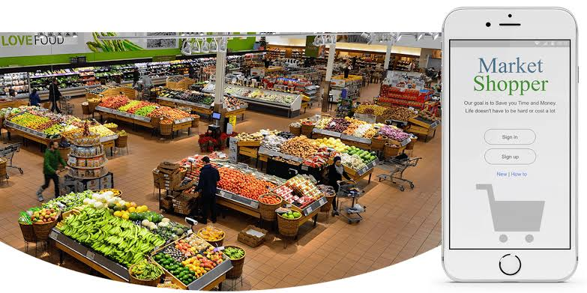
WebSite ProtoType

Slide 9
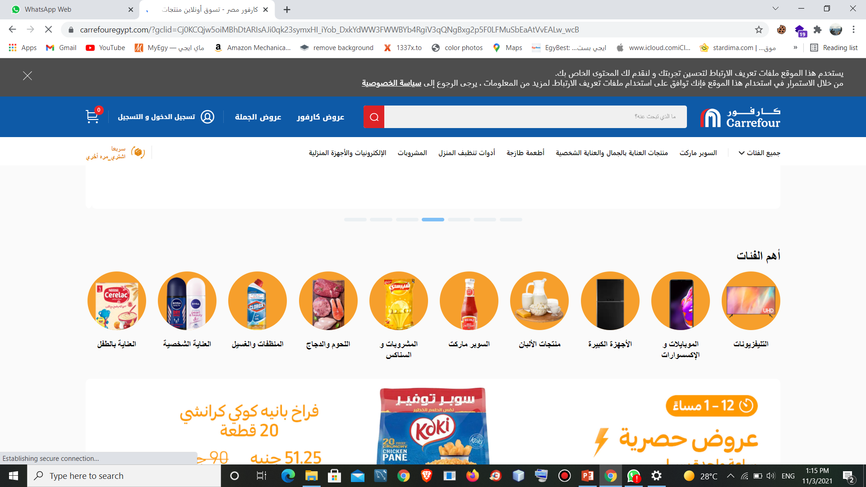

Slide 10
Pros and cons
That is buys al lot of tings same mobile phones and labtops and fruit and lot of things of foods
But cons when customer order online he cant show delivary on google maps

Slide 11
Home page_eng and user page _arb:

Slide 12
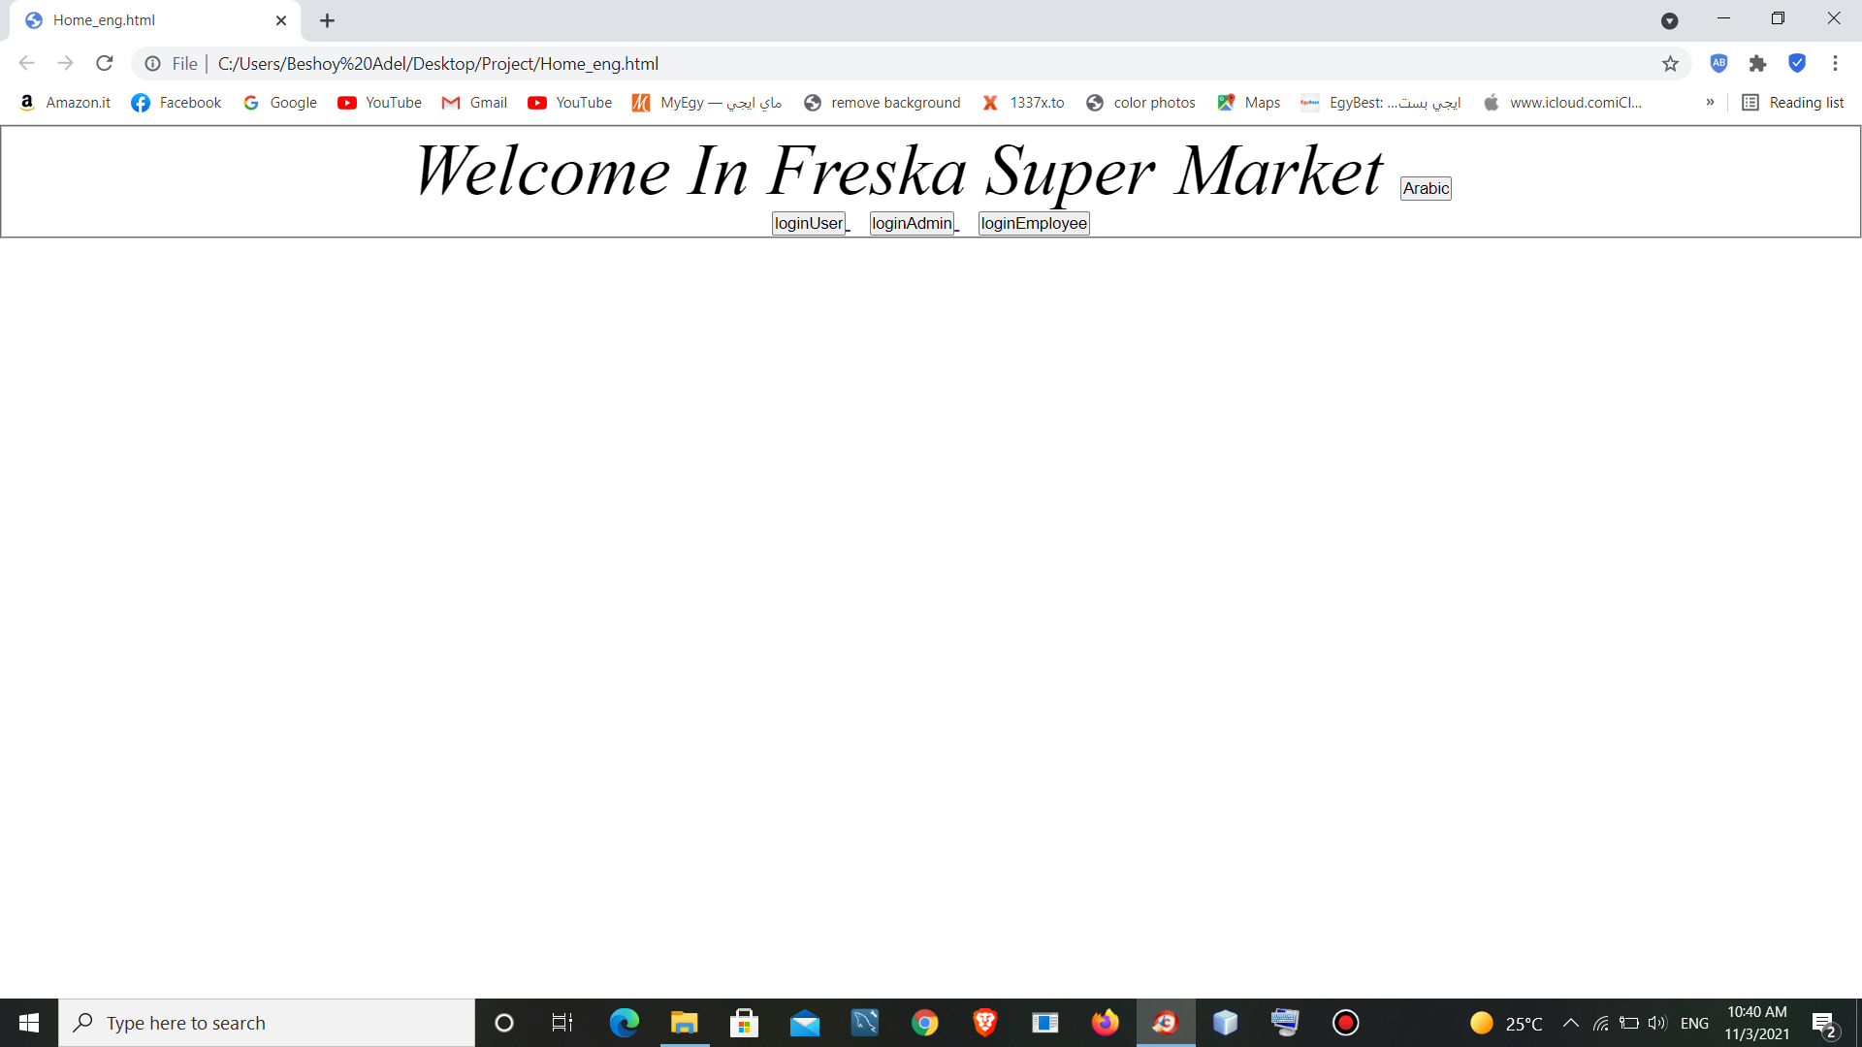

Slide 13
Admain page _eng and Admain page_arb :

Slide 14
Sign up_employee_eng and Sign up_employee_arb:

Slide 15
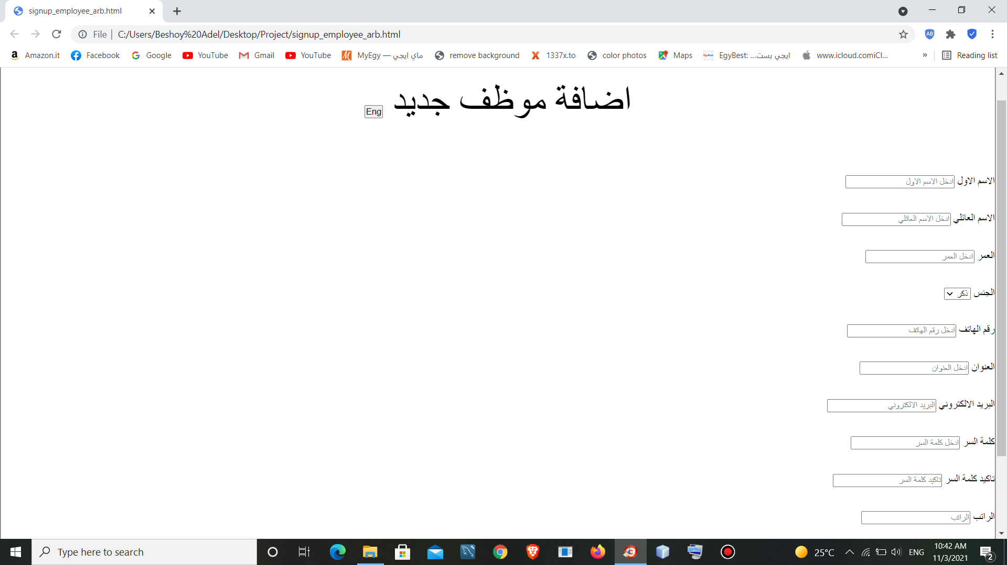

Slide 16
Sign up_user_eng and Sign up_user_arb:

Slide 17
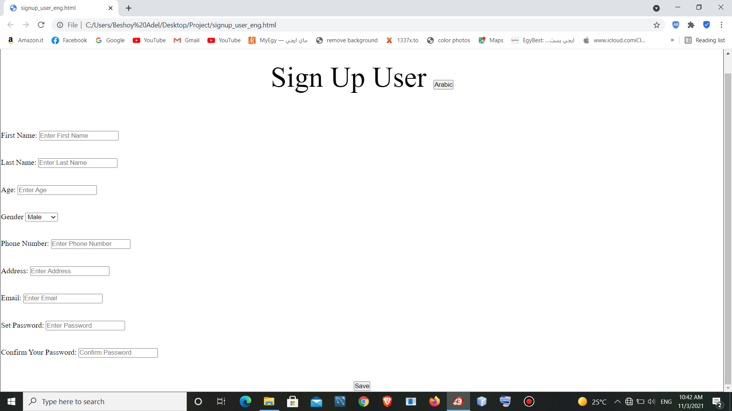

Slide 18
Sign in_employee_eng and sign in_employee_arb:

Slide 19
Sign in_user_eng and Sign in_user_arb:

Slide 20
Sign in_admain_eng and Sign in_admain_arb:

Slide 21
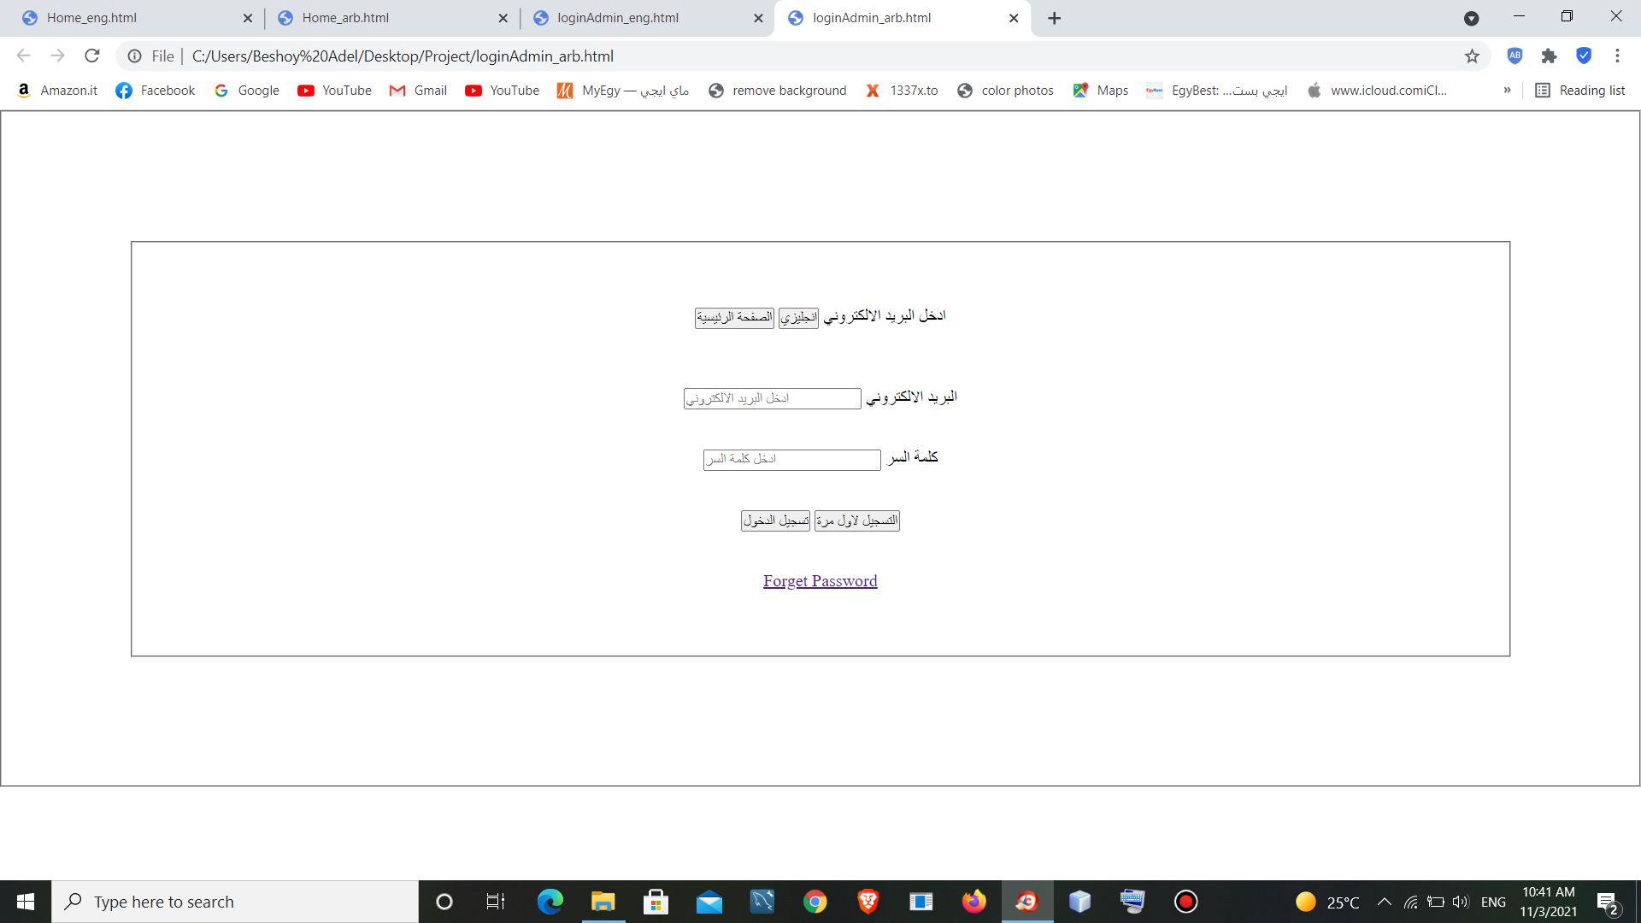

Slide 22
Shopping_eng and Shopping _arb:

Slide 23
cost_eng and cost _arb:

Slide 24
delivary_eng and delivary _arb:

Slide 25
Employee page_eng and Employee page _arb:

Slide 26
user page_eng and user page _arb:

Slide 27


Slide 28
Thank you

